Slide 1

TRENDY TOO
Task - 1

Slide 2
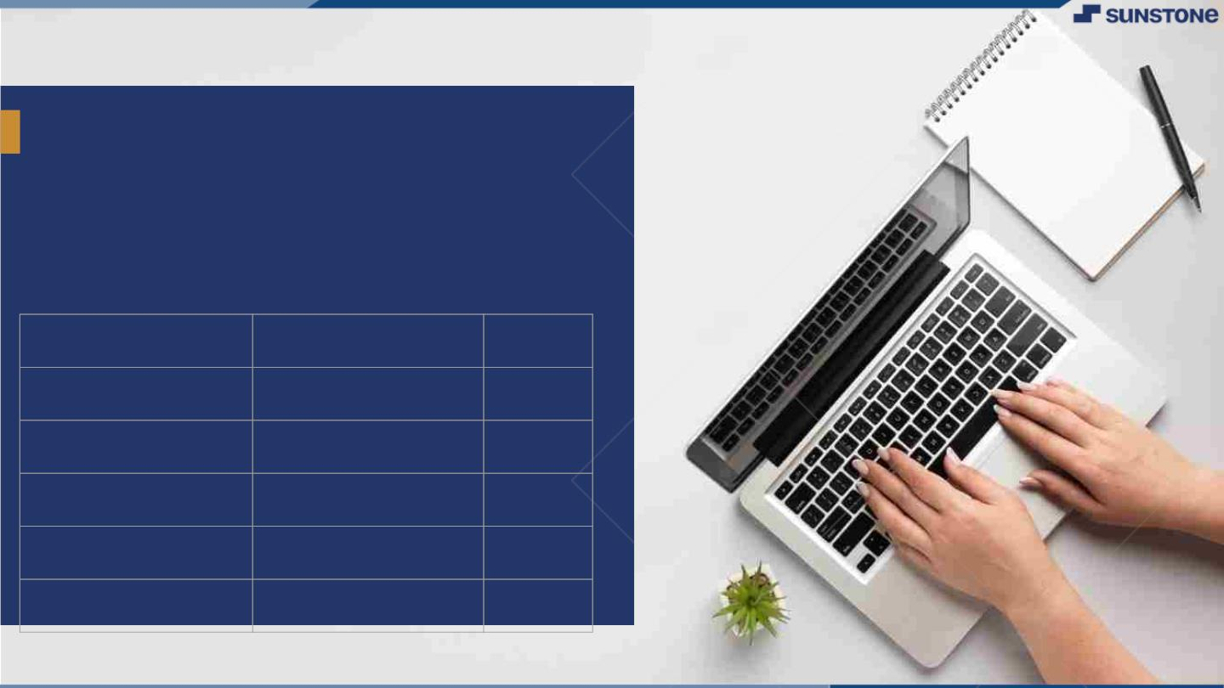
TRENDY TOO
▪
TrendyToo is a dynamic e-commerce platform poised to revolutionize the online shopping experience. Specializing in the sale of cutting-edge shoes and dresses for men and women, TrendyToo aims to seamlessly merge style and convenience.
LMS Username
au920820104018
au920820104026
au920820104033
au920820104019
Name
LEO.T
PRADEEP RAJ.R.S
SANJAY.H
MATHIVANAN.V
Batch
CC4
CC4
CC4
CC4

Slide 3

Step-WiseꢀDescription
Market Research: Analyze competitors and market trends to inform strategic decisions.
Design and Development: Create a visually appealing and user-friendly e-commerce platform focused on shoes and dresses.
Content Creation: Develop engaging product descriptions and high-quality visuals to showcase merchandise effectively.
Testing: Ensure a seamless user experience through thorough testing, building trust with customers before lunch
Marketing: Implement a robust digital marketing strategy to drive traffic and boost sales for TrendyToo.
Summaryꢀofꢀyourꢀtask
we are creating an e-commerce website named TrendyToo, specializing in shoes and dresses. The key steps include thorough market research to understand competitors and trends, designing and developing a visually appealing and user-friendly platform, crafting compelling content for products, conducting thorough testing for a seamless user experience, and implementing a robust digital marketing strategy to drive traffic and sales.

Slide 4
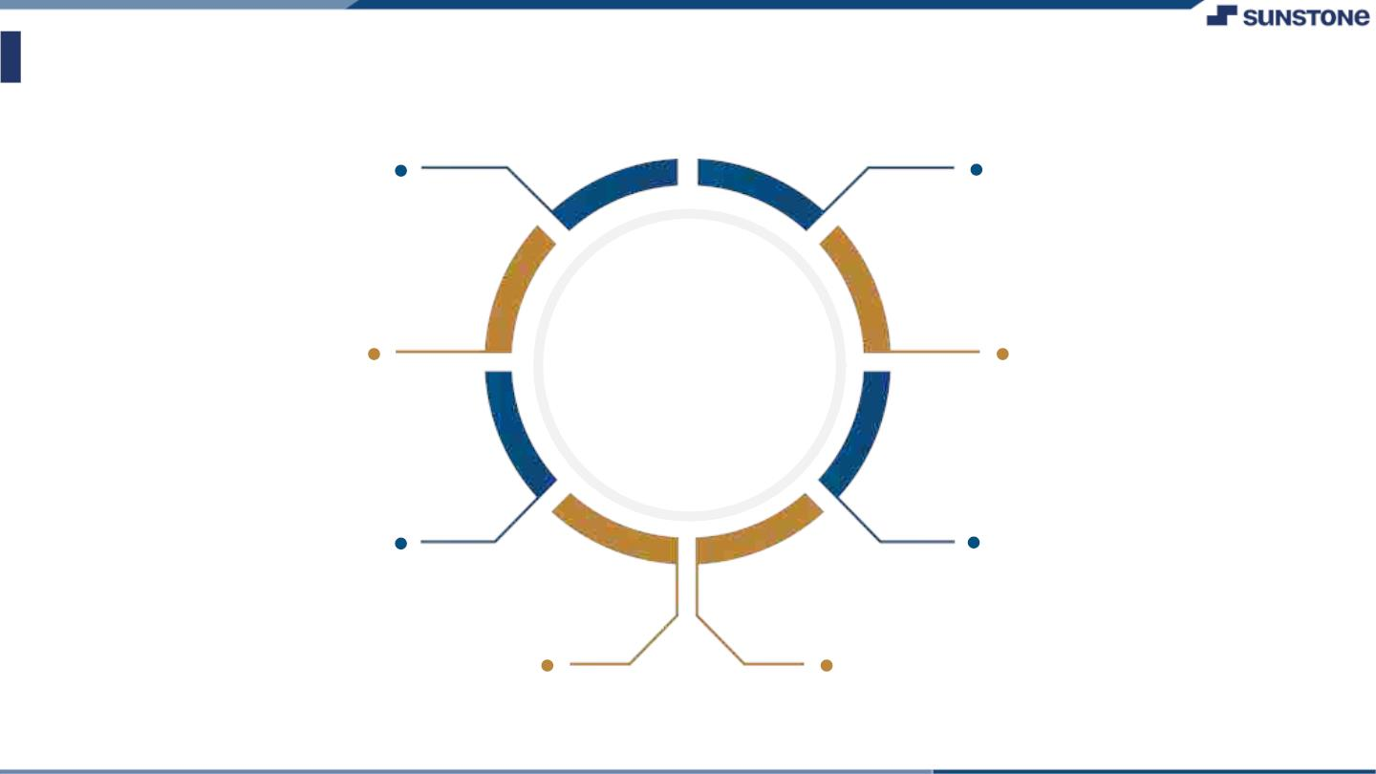
AssessmentꢀParameter
Gatherꢀrequirementsꢀforꢀtheꢀ
project
addꢀReadme.mdꢀfileꢀwithꢀ
descriptionꢀofꢀtheꢀproject
Prepareꢀdatabaseꢀdesignꢀ
schemas
Check-List
Commitꢀallꢀchangesꢀwithꢀ"firstꢀ
commit"
Getꢀyourꢀinitialꢀprojectꢀ
Structureꢀready
createꢀaꢀrepositoryꢀonꢀgithubꢀ
realtedꢀtoꢀproject
Initiateꢀaꢀgitꢀrepository
Pushꢀyourꢀchangesꢀtoꢀgithub

Slide 5

Submission Github
githib

Slide 6


